Slide 1
API
Module 1

Slide 2
Course Agenda
Topics:
Module 1: Application Programming Interfaces
Module 2: Open Source Software
Module 3: Cloud Development Frameworks
Module 4: Reliability, Scalability, and Resiliency
Module 5: Code Repositories
Module 6: Maven and Jenkins
Module 7: Container Fundamentals
Notes:
Instructor Notes:
Please walk through the course agenda with participants, briefly introducing what you’ll be talking about in each topic.
Participant Notes:
There are x main sections to this course:
Module 1: Application Programming Interfaces
Module 2: Open Source Software
Module 3: Cloud Development Frameworks
Module 4: Reliability, Scalability, and Resiliency
Module 5: Code Repositories
Module 6: Maven and Jenkins
Module 7: Container Fundamentals

Slide 3
Facilities and Logistics
Please turn off or set your phones to vibrate!
Restrooms Emergency Exiting Phones and Computers Sign In Breaks and Lunch Participant Manual and Workbook Seating Q & A
Notes:
Instructor Notes:
Please make a brief announcement letting class participants know where facilities are in relationship to the classroom, and to turn off all electronics.
Remember that this is a 1 day offering.
This is also a good opportunity to remind everyone to sign in on the class roster and ensure that everyone has received a copy of the manual.
Participant Notes:
Ensure that you have signed the course roster.
Ask the instructor about any facility questions that you have.
Participate in the conversation about time for breaks and lunch; letting the instructor know any special circumstances that you may have.
Please turn off Wi-Fi on your laptop and set your mobile phone to vibrate or turn it off. There will be breaks where you can check email, if needed.

Slide 4
Your Instructor
Insert Photo Here ↓
Instructor Name Instructor Credential #1 Instructor Credential #2 Instructor Credential #3 Instructor Credential #4 Instructor Fun or Unique Fact
Notes:
NOTE: This slide does NOT get included in the Instructor or Participant Guides
Instructor Notes:
Please customize this slide prior to the course.
Provide a current head shot, your name, any credentials that you would like to include, and a fun fact about yourself.

Slide 5
Your Instructor
Insert Photo Here ↓
Instructor Name Instructor Credential #1 Instructor Credential #2 Instructor Credential #3 Instructor Credential #4 Instructor Fun or Unique Fact
Notes:
NOTE: This slide does NOT get included in the Instructor or Participant Guides
Instructor Notes:
Please customize this slide prior to the course.
Provide a current head shot, your name, any credentials that you would like to include, and a fun fact about yourself.

Slide 6
Module Objectives
After this module, participants will be able to:
Identify the elements of data communication
Compare and Contrast Popular Serialization Formats
Differentiate between Protocols
Understand API service frameworks
Implement Security and Authentication Best Practices

Slide 7
API Introduction

Slide 8

What is an API?
API stands for Application Programming Interface.
It is a means for allowing developers (not users) to access functionality.
A good API should shield the user from the app internals.
Notes:
Instructor notes:
Instructor Notes are the same as Participant Notes.
Please present the Participant Notes. Participant Notes: This slide introduces the topic of APIs. API has become very popular as a best practice for software development. They implement the idea of “decoupling” which results in many benefits.

Slide 9
History

Slide 10


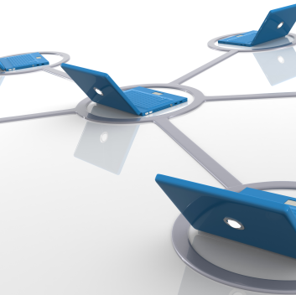
Early History of APIs: Libraries
Early libraries consisted of a list of procedures
Well-defined parameters
Return types
Early libraries linked statically
Included object file at link process
Dynamic linking or late binding
Windows DLL/Unix .so
Allows code to be linked at runtime
Notes:
Instructor notes:
Instructor Notes are the same as Participant Notes.
Please present the Participant Notes.
Participant Notes: Libraries are the first form of API. It was a way for a vendor or programmer to open the functionality of the application.

Slide 11
API Forms
Object Oriented APIs
Remote Procedure Calls: RPC
Message Queuing
Web Services
Web APIs
Classes rather than Procedures
Data + Methods
Remote objects / Remoting
Use IDL to provide class metadata
Examples: CORBA, DCOM
Tended to be heavyweight, and fragile
Not really cross-platform
Distributed Systems: Need to remotely execute code
Interface Definition Language (IDL)
Facilitates communication from client to server
Early RPC has no failure protocol
No guaranteed delivery
IBM MQSeries: Saw communication as series of messages
Allowed reliable delivery
More failure tolerant
Decouple Client from Server
More reliable
Loose Coupled
Message Infrastructure has steep requirements.
Web technologies like HTTP, HTML, XML used for APIs
Open Standards, Cross Platform
Implement RPC and Object Remoting via HTTP/WWW.
Service-Oriented Architecture
Sees distributed application as services
Communicate via XML (SOAP)
XML-based IDL (WSDL)
Problems:
Complexity
Fragility
The Web is built on open standards
HTTP Protocol
HTML/CSS/JavaScript client-side
APIs can use the open protocols
So ANY user can use it
Easier to use than TCP/UDP Programming
HTTP ports usually open on network firewalls
Able to communicate over public internet (if desired)
Notes:
Instructor notes:
Instructor Notes are the same as Participant Notes.
Please present the Participant Notes. Participant Notes: Class Libraries: Class Libraries are the OOP version of earlier libraries. Instead of a list of procedures, class libraries store classes of objects: Data and methods. With OOP's principles of inheritance, polymorphism, and encapsulation, these objects allow for better code-reuse and more modular design than traditional libraries. The problem with class libraries as an API is that extending OOP principles to distributed systems are difficult, heavyweight, and fragile. Security is another major concern, as remote users can maliciously use application objects. Another issue is distributing across platforms. Traditional class libraries in, say Java, are of no use to a developer in .NET. Communication between systems requires a different sort of API. Remote Procedure Calls (RPC): Remote Procedure Calls (RPC) are a procedural (rather than OOP) form of API. Database stored procedures are similar. The idea behind it is that it allows a network API to be published that allows users to use the service. The RPC is still the basic paradigm around distributed APIs. Ironically, this old, seemingly outdated mechanism is making a comeback, because many frameworks now exist to provide this useful functionality. The problem with the RPC is how do we ensure failure. If the server is "down" the RPC fails. If the client is down, again, it fails. The RPC also is limited because it is essentially a one-way request-response mechanism. There's no direct way for the server to push messages to the client, and even if there was a way, there's no way to guarantee that clients would receive such messages. Message Queuing: Messaging fundamentally rethinks how an API works. Rather than seeing API as a series of calls, it is a series of messages. The Actor Model is a good way of viewing this. The Actor model sees the interaction as a conversation rather than as an imperative framework. To make the actor model work, we need some kind of message queuing. Distributed systems are inherently lossy and unreliable. Message queuing is a necessary part of making this a reliable connection. Web Services: Web Services first arose out of necessity. Object remoting systems couldn't get through web firewalls. Objects themselves weren't cross-platform. We needed a way to communicate over the web, in a platform-independent way. So, we have Web Services. Web services tunnel through the web, so they are web-friendly. They use XML, which for all its many faults is an open standard and supported by all systems. Web APIs: Web-oriented products needed a way to communicate via APIs. For these products, the web WAS the medium of delivery of the application, and everything had to be accessible over the web. This is different than the XML Web services that merely used the web as a convenient transport mechanism and serialization format. Web APIs are a way to programmatically interface with the Web itself.

Slide 12


Google Maps and Twitter
Google Maps
Twitter
Google Maps is an early Web API (2006)
Early users "hacked" Google Maps to create location applications.
"Where's the closest XYZ store?"
Google Maps Mash-ups.
Google Maps API
Google released a public Google Maps API.
Anyone could call the API and integrate Google Maps.
Twitter is the first modern Web Service Application
The primary interface is the API, not the website.
Users connect to the Twitter "firehose" via APIs.
Uses JSON to communicate.
Example Use Case: Sentiment Analysis on Stock
Users search for tweets mentioning a stock.
Score sentiment (positive/negative) about that.
Enable stock trading from results.
12
Notes:
Instructor notes:
Instructor Notes are the same as Participant Notes.
Please present the Participant Notes.
Participant Notes: Google Maps: Google maps represented an early web UI. For the first time, a web application was able to be embedded into other products. At first, this was more of a "hack" -- developers would use the Google Maps application itself but "mash up" in new ways -- for example, to show the locations of coffee shops, etc. Google eventually recognized this and created a public API for its map service, which gave rise to Google's Cloud Web APIs. Twitter: Twitter is the fist modern web service application for several reasons: First, it was an application that clearly differentiated between a website and the application. Twitter has many "clients", including a web client, but that is quite separated from the core functionality of twitter. It's one of many windows into the twitter application. Second, it uses HTTP (REST) as its main API. While this is standard today, at the time most web services used antiquated protocols like SOAP. By using JSON instead of the cumbersome XML, it made it much easier to process results, particularly client side.

Slide 13
Protocols and Data Formats

Slide 14
Introduction

Slide 15

Communication Requirements
Claude Shannon (Bell Labs):
"Father of Information Theory"
1948: "Mathematical History of Communication"
Notes:
Instructor notes:
Instructor Notes are the same as Participant Notes.
Please present the Participant Notes.
Participant Notes:
Claude Shannon formalized notions that people use to take for granted. For example, what is information? Well, one bit of information is defined as the information that I get when I ask a “Yes or No” question and I get back the answer.
Image source: https://en.wikipedia.org/wiki/Claude_Shannon

Slide 16
Elements of Communication:
Source: Generates message data.
Transmitter: Produces signal.
Channel: Medium for transmission.
Receiver: Reconstructs message from signal.
Destination: Entity for which message is intended.
Message: Information transmitted.
Notes:
Instructor notes:
Instructor Notes are the same as Participant Notes.
Please present the Participant Notes.
Participant Notes:
These bullet points introduce the major definitions in cybernetics, which we then build upon.

Slide 17



Communication Terms
Serialization (the transmitter):
Process to transmit data structures or state into a format for storage or transmission.
Deserialization (the receiver):
The reverse process.
Protocol (the communication process):
A set of rules allowing:
Two or more entities to transmit a message.
Notes:
Instructor notes:
Instructor Notes are the same as Participant Notes.
Please present the Participant Notes.
Participant Notes:
Here we introduce the technical terms of how information exchange happens. These definitions will be later translation into specification and then into code.

Slide 18
Protocols

Slide 19
SOAP, REST, and GRPC
SOAP
REST
GRPC
SOAP uses XML
Describes service using WSDL file
Not often used in modern era
REST is technically not a protocol
REST can use any serialization
JSON
Protobuf
REST does NOT use RPC
Protobuf is only a serialization format, not a communication protocol
The communication protocol Google uses for Protobuf
Brings Protobuf in line with Thrift, Bond, or Avro
Notes:
Instructor notes:
Instructor Notes are the same as Participant Notes.
Please present the Participant Notes.
Participant Notes:
SOAP: SOAP was the first data interchange format for web services. Then Amazon-designed REST replaced it.
REST: RESTful protocol was designed by Amazon and is now the de facto standard. It wins due to its simplicity, and today, due to its widespread use. It is easy to use and there are multiple libraries for the implementers.
GRPC: One more differentiate between a serialization format (that is how you write the data) and a communication protocol (that is how you send that data to the client).

Slide 20

SOAP Web Services
SOAP (Simple Object Access Protocol) was invented at Microsoft in 1998
Submitted for standardization in 2000.
Relies on Open Standards:
Uses HTTP (or UDP or SMTP, but not commonly)
Uses XML for serializing Data
Provides a way to loosely couple systems
Bypasses security problems with COM/DCOM
Cross platform beyond Microsoft Technologies
Clients can read the WSDL (Web Service Description Language)
Uses RPC (Remote Procedure Call) model
Client makes a procedure call to the server.
Notes:
Instructor notes:
Instructor Notes are the same as Participant Notes.
Please present the Participant Notes.
Participant Notes: SOAP isn't really used much anymore, though there are a huge number of legacy applications that use it. Mainly, SOAP is of interest as an iteration of modern web services, that are going to be using RESTful principles. The method of using TCP sockets for "remoting" between systems was fundamentally broken. Corporate firewalls locked down various TCP ports and the concepts of making distributed applications based on TCP sockets weren't going to work. Somehow, we needed services that could talk on open standards using HTTP protocols and standard ports, which are guaranteed to be open. By today's standards, the idea of using a technology like DCOM for distributed systems was never going to work well. The very definition of "tightly coupled" -- DCOM was single-platform, proprietary, unsupported by other vendors, and generally created brittle, fragile systems that didn't work well as distributed systems. Web Services, even in their most basic form, solved all of these problems. They were based on open-standards, cross-platform, and allowed loose coupling between systems. The RPC model works well for some systems, as we can see that it has found its way even into much more modern systems like Thrift.

Slide 21
SOAP and State and Disadvantages
Serialization Specific to One Platform
Disadvantages
SOAP web services can be stateful.
State stored per-user session in DB.
XML is bulky, verbose, and inefficient.
Roles fixed as client and server.
Web Service APIs quickly grew out of control, with huge WSDLs.
Nonstandard interaction model.
Notes:
Instructor notes:
Instructor Notes are the same as Participant Notes.
Please present the Participant Notes.
Participant Notes: Statefulness, while discouraged in REST systems, is ubiquitous in SOAP. There are actually two kinds of state: a server-side state tied to the user's session, and a client-side state stored in hashed browser data, called the ViewState. The latter is almost never used by modern APIs, and the former has significant scaling limitations, which is why REST discourages statefulness.
SOAP was revolutionary in its time, but as a first generation web-service technology there were many ways in which it did not lead to its promise. XML now has a reputation for verbosity, unreadability, and clumsiness, but its time it was the epitome of openness. The real problem with SOAP web services is that there was no standard way to access one. Every SOAP web service would have its custom API, which although was available to the WSDL, meant that applications essentially had to be custom written to use the API.

Slide 22

REST
REST:
REST is: Representational State Transfer.
It is NOT a protocol, but an architectural pattern.
Notes:
Instructor notes:
Instructor Notes are the same as Participant Notes.
Please present the Participant Notes.
Participant Notes: REST is one of the organizational paradigms of the modern web service movement. Although RPC models are still very popular, it is safe to say that most developers have a certain expectation that a modern API will correspond to REST. We will be covering REST in detail in the upcoming discussion.

Slide 23
Serialization

Slide 24

Serialization Options
There are a number of ways we can serialize our data.
Platform Specific (Java/.NET/Python)
COMMON SERIALIZATION
XML
JSON
Thrift
Protobuf
Avro
Notes:
Instructor notes:
Instructor Notes are the same as Participant Notes.
Please present the Participant Notes.
Participant Notes:
Serialization is technical drill-down into the implementation of communication. All ‘information’ or ‘message’ need to be serialized into bytes that will be communicated in the information exchange.

Slide 25
Platform-Specific Serialization
Serialization Specific to One Platform
Disadvantages
Java Serialization
Python Pickle
.NET Remoting
Typically inefficient and slow
Not portable
Not cross-platform
Notes:
Instructor notes:
Instructor Notes are the same as Participant Notes.
Please present the Participant Notes.
Participant Notes:
Depending on the platform where you are implementing serialization, there will be some protocols that are not portable between platforms.

Slide 26

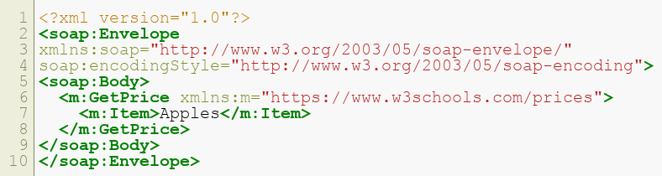
XML and Example
XML was historically used, especially with SOAP.
Not frequently used:
Complex
Verbose
Inefficient
Not very readable by humans
Example:
Notes:
Instructor Notes:
Instructor should go through the example element by element and explain what each element does.
Participant Notes:
SOAP XML Services encapsulate data in the xml wrapper. The XML wrapper is an document format rather than a record format so the entire XML document must be completely parsed before any of the data can be read.
In this example, we are specifying the XML namespace (soap), and the encoding style (soap) based on standard w3 descriptions which must be read by the recipient in order to correctly parse the data.
In the Body, we are making a request to the RPC method called GetPrice, with a parameter to the call as Apple. Being an RPC model, the requester will be expecting a response from the recipient.
While SOAP works fine for this simple example, it is cumbersome and verbose, and somewhat brittle given the fact that an error in reading the XML request renders the entire document unreadable.
However, it is an open-standard, and is well understood.

Slide 27

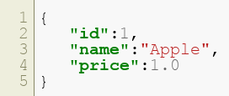
JSON and Example
JSON: JavaScript Object Notation
Advantages:
Human readable
Self-describing
Easy to parse
Disadvantages:
Verbose
Slow to scan sequentially
JSON can be compressed (ZIP, gzip, etc.)
Example:
Notes:
Instructor Notes:
Let’s go through the elements of this JSON. ‘id’ is the name of the field, and ‘1’ is the value. This ‘1’ is a string.
Furthermore, ‘name’ is the name of the field, and ‘Apple’ is the value, and it is a string.
‘price’ is the name of the field and ‘1.0’ is the value, and it is a double.
Participant Notes:
JSON is the new darling. Today, programmers will always choose it by default when they are looking for text-based interchange format.
This message is functionally identical to the previous example. However, being far more compact (relatively speaking), and simple to parse makes it far preferred. It’s also quite easy to “eyeball” by humans.
Despite being relatively more compact and readable than XML, it is still not a particularly efficient means for storing or reading code. Querying data from a JSON file will prove to be far inferior to many of the binary formats we use for storing data. These disadvantages mean that JSON is often compressed for efficiency’s sake.

Slide 28
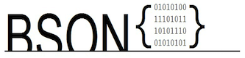
BSON
Binary JSON:
Uses packed binary format
Uses a "length" field to facilitate faster scanning
Row-based
Notes:
Instructor notes:
Instructor Notes are the same as Participant Notes.
Please present the Participant Notes.
Participant Notes:
BSON is one of the first binary protocols that were designed specifically for programmers. There are libraries available to converting Java objects to BSON, and the like.

Slide 29

Protocol Buffers (protobuf)
protobuf:
Developed by Google
Both a format and a protocol
Binary
No RPC, but gRPC framework exists to do RPC with protobuf
Notes:
Instructor notes:
Instructor Notes are the same as Participant Notes.
Please present the Participant Notes.
Participant Notes:
Protobuf was created by Google and immediately became extremely popular. It is the internal preferred format for Amazon Machine Learning, due to its speed. There are many libraries for the protobuf protocol available today.

Slide 30
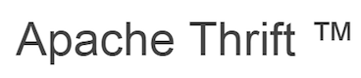
Thrift
Thrift:
Developed by Facebook
Both a format and a protocol
Binary
Supports versioning
Notes:
Instructor notes:
Instructor Notes are the same as Participant Notes.
Please present the Participant Notes.
Participant Notes:
Thrift is the first very popular format for exchanging data between different programming languages and between different systems. For example, many NoSQL implementation support Thrift as the first data exchange protocol.

Slide 31

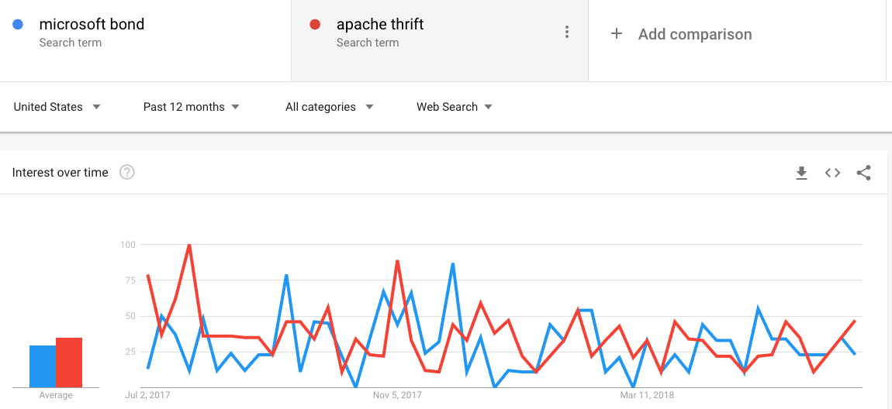
Bond
Bond:
Developed by Microsoft
Both a format and a protocol/RPC
Binary
Notes:
Instructor notes:
Instructor Notes are the same as Participant Notes.
Please present the Participant Notes.
Participant Notes:
It is interesting to note that Bond and Thrift are about equally popular.

Slide 32

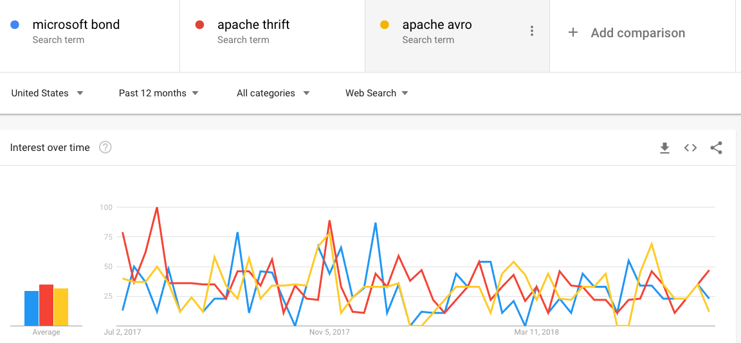
Avro
Avro:
Mainly used in Hadoop/Big Data
Supports RPC
Self-describing
Advanced schema evolution features
Row-based
Notes:
Instructor notes:
Instructor Notes are the same as Participant Notes.
Please present the Participant Notes.
Participant Notes:
As you can see, Avro format competes with both Bond and Thrift.

Slide 33

Parquet
Parquet:
File and Serialization format
Uses Thrift for RPC/protocol
Columnar
Limited schema evolution
Self-describing
Notes:
Instructor notes:
Instructor Notes are the same as Participant Notes.
Please present the Participant Notes.
Participant Notes:
Parquet was designed by Cloudera and it is their preferred format. However, they will read and write their competing format, ORC.

Slide 34
Comparison
 | Protocol | RPC | Human Readable? | Self Describing | Binary | Compressed | Schema Evolution | Storage
XML | No | No | Yes | Optional | No | No | No | Row
JSON | No | No | Yes | Optional | No | No | No | Row
BSON | No | No | No | Optional | Yes | No | No | Row
Thrift | Yes | Yes | No | No | Yes | No | No | Row
Bond | Yes | Yes | No | Optional | Yes | No | Yes | Row
Protobuf | Yes | No | No | Optional | Yes | No | Yes | Row
Avro | Yes | Yes | No | Yes | Yes | No | Yes | Row
Parquet | No | No | No | Yes | Yes | Yes | Limited | Column
Notes:
Instructor notes:
Instructor Notes are the same as Participant Notes.
Please present the Participant Notes.
Participant Notes:
In this summary table, you can see the relative pluses and minuses of all formats. More correctly, advantages and disadvantages. They relate to specific needs. We also showed you how to use Google Trends to pick a winner.

Slide 35
Authentication

Slide 36

The Problem
You develop a great web service.
But you need to secure it.
Do you really need to secure it?
YES!
How to do that?
Notes:
Instructor notes:
Instructor Notes are the same as Participant Notes.
Please present the Participant Notes.
Participant Notes: We are introducing the idea here of how to secure web services. In general, web services need authentication and authorization to protect their contents against attackers. Even very simple web services deployed in a trusted environment.

Slide 37
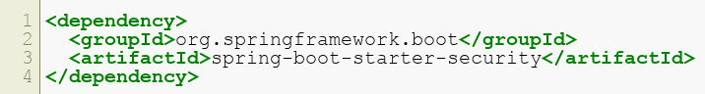
HTTP Basic Authentication & Spring Basic Authentication
HTTP Basic Authentication
Uses HTTP Standard Headers
Combine Username + Password to Base64 string
Example: myusername:mypassword
NOT encrypted. So you need to use SSL!
Spring Basic Authentication
Basic Authentication can be set up by Spring boot
By including spring-boot-starter-security
Notes:
Instructor notes:
Instructor Notes are the same as Participant Notes.
Please present the Participant Notes.
Participant Notes: HTTP Basic Authentication is, as its name implies, basic. Unfortunately, it's not particularly secure. There are a lot of problems with this. It's vulnerable to cross-site request forgery, CSRF, for one thing, we will discuss later.
Spring Boot gives us a reasonably good "basic" authentication with minimal effort. As a matter of fact, we don't need to do anything except add the spring-boot-starter-security artifact to our project. That said, simply authenticating doesn't actually protect anything.

Slide 38
Cross-Site Network Forgery
What is Cross-Site Network Forgery?
How to Prevent CSNF?
When an attacker hijacks a user token
Reuses token for malicious purposes
Use SSL
Enable CSNF Mode
Notes:
Instructor notes:
Instructor Notes are the same as Participant Notes.
Please present the Participant Notes.
Participant Notes: Cross-Site Network Forgery means that if an attacker can grab a hold of an HTTP header of a request, then he or she can impersonate the user for the remainder of the session, possibly compromising user data. To protect against CSNF, we need a good programming discipline and a test penetration team that tells the programmers what to do.

Slide 39

Spring Boot
Spring requires a lot of configuration.
Problem: I have simply replaced:
Lots of code with lots of XML!
Can't we autoconfigure our app?
Do we need to configure everything?
The answer to this is Spring Boot:
Spring Boot makes it easy to create stand-alone, production-grade Spring-based Applications that you can run.
Notes:
Instructor notes:
Instructor Notes are the same as Participant Notes.
Please present the Participant Notes.
Participant Notes:
The primary goals of Spring Boot are:
Provide an accelerated start so users can get up to speed quickly.
Set up from the start according to convention so things “just work” but make it easy to change those conventions when needed.
Provide modules to help service application needs like authentication, security, embedded servers, configuration, and health checks
Avoid auto-generated code and extensive XML configuration that has characterized Spring Framework applications in the past.

Slide 40
Microservices

Slide 41
Monolithic Services vs. Microservices
Monolithic Services | Microservices
Traditional services are defined as monolithic | “Do one thing and do it well” Each microservice does minimal level of useful functionality
Monolithic service does all of the following: Presentation Business logic DB access Application integration | Application composed of interconnecting services: Services communicate via RPC or Messaging Services do their own persistence
Disadvantages of monolithic services: Hard to fully understand Difficult to scale Reliability
Notes:
Instructor notes:
Instructor Notes are the same as Participant Notes.
Please present the Participant Notes.
Participant Notes: Monolithic services are what we're trying to move away from. Monolithic services are built from the "do everything" model, which has all of the drawbacks mentioned above.
Microservices is a software development technique—a variant of the service-oriented architecture (SOA) architectural style that structures an application as a collection of loosely coupled services. In a microservices architecture, services are fine-grained and the protocols are lightweight.
Microservices have become so popular in the recent years that one can safely state that it is now a basic principle of building modern software.

Slide 42
UNIX Philosophy
Philosophy
Small is beautiful
Make each program do one thing well
Build a prototype over efficiency
Store data in flat text files
Use software leverage to your advantage
Use shell scripts to increase leverage & profitability
Avoid captive user interfaces
Make every program a filter
Notes:
Instructor Notes: Mike Gancarz cam up with the UNIX philosophy https://en.wikipedia.org/wiki/Unix_philosophy#Mike_Gancarz:_The_UNIX_Philosophy Participant Notes: Why does the UNIX Philosophy matter? It is because this philosophy led to the creation of the most successful operation system today, Linux. Not to diminish the importance of Windows, but today, the vast majority of systems today are built on top of UNIX (the desktop PC being the primary exception). Linux, Mac OS X, Android, iOS, and most embedded devices all use a UNIX-like OS. There is a reason for its popularity in building modular systems.

Slide 43
Distributed Systems
Microservices are the “UNIX philosophy”
They are the philosophy in distributed systems and in services
Does this mean that I can only do this on Linux?
NO!
“UNIX philosophy” can be used on Windows, too
It’s just an idea
Notes:
Instructor notes:
Instructor Notes are the same as Participant Notes.
Please present the Participant Notes.
Participant Notes:
Microservices are a new way of practically building distributed systems. But many of the distributed systems ideas come from operating system design. One of the most successful OS’s has been Linux. It is not surprising then that in building microservices architecture, much has been borrowed from Linux.

Slide 44
Microservice Advantages and Architecture Advantages
Microservice Architecture Advantages
Microservice Advantages
Scalability: Functionality is already distributed. Easy to break it up during deployment.
Testability: Each portion is minimal, so easy to test. TDD
Each microservice is relatively small.
Easier for a developer to understand.
The IDE is faster, enhancing developer productivity.
The web container starts faster, making developers more productive, and speeding up deployments.
High rate of change.
Low cost of change.
Notes:
Instructor notes:
Instructor Notes are the same as Participant Notes.
Please present the Participant Notes.
Participant Notes: TDD stands for Test Driven Development. TDD and microservices are an especially good fit.
Test Driven Development is, quite simply, a test-first approach to development. Tests should be done concurrently with requirements, so as requirements are defined, then tests plans are designed to test those requirements. As functionality is implemented, then tests that start out having failed will pass.
Why is this a good thing, and what does this have to do with Microservices?
Smaller functionality (Microservices) is easier to test
Having robust testing of all requirements means that services can be developed in isolation.
Test-First functionality ensures that service components are correctly talking to one another.
Test-driven development or TDD is a development philosophy that emphasizes very short development cycles. With
A good reference: https://www.ness.com/microservices-architecture-and-design-principles-2/?cn-reloaded=1

Slide 45
The 5 Principles of Microservices Design and Implementation
Anyone implementing microservices will do well to be mindful of the following principles
Elastic
Resilient
Composable
Minimal
Complete
Must be able to scale up or down
Multiple stateless instances of service
Routing and load balancing
Registration, naming, and discovery
Service will have multiple Instances
High availability
Redundancy
Fault Tolerance
No single point of failure
No one service is indispensable
Load/Risk distribution
Service instance dynamic
Common, uniform interface
REST principles
Composition patterns:
Aggregation
Linking
Caching
Proxies
Gateways
The "Micro" in Microservices!
Entities should be cohesive
SRP (Single Responsibility Principle)
One business function
Not necessarily small in size
(See Complete)
But as small as possible
Minimize coupling with other services
Tight Coupling limits reusability.
Should fully accomplish business function
Don't "split" services for the sake of it
Each module is as big as it needs to be
"Micro" doesn't always mean small
Notes:
Instructor notes:
Instructor Notes are the same as Participant Notes.
Please present the Participant Notes.
Participant Notes:
Elastic: These are the building blocks which are not obvious and which help build good microservices. Include these into your design.
Resilient: These principles explain how you can make your microservices resilient. This means building reliable systems out of non-reliable components. That is how modern software systems are built. Amazon mantra: plan for failure and then nothing fails.
Composable: REST is a good example of an enabling technology. Take its principles and apply them to your microservices.
Minimal: This is the basic lesson of microservices. SRP (Single Responsibility Principle) will do well in many other areas of software, but in microservices, it is essential in defining the scope of each of the microservice. It simplifies writing tests as well.
Complete: This is the last and final principle of microservices construction. “Decouple” is the key principles of AWS services construction. However, there are some ‘gotchas’ on the way, and the bullet points here explain when not to be a stickler for “micro” and when to make a microservice reasonably big.

Slide 46
JAX-WS and JAX-RS
JAX-WS
Java API for XML Web Services (JAX-WS) Java API for SOAP Part of Java EE platform Metro: Reference Implementation for JAX-WS Demonstration
JAX-RS
JAX-RS is an API, not an implementation Jersey is a reference implementation of JAX-RS
Notes:
Instructor Notes:
At Metro, here the instructor will demonstrate the JAX-WS implementation. We don’t go deeper into this because there is a more prevalent REST implementation.
Participant Notes:
JAX-WS: We mentioned the SOAP protocol before. However, when you are programming in Java, you need a library that will form the SOAP request for you. One such library, called JAX-WS, is included into the standard Java EE. Both Java EE and SOAP are on their way out, even though you will still find jobs using these technologies.
JAX-RS: As we mentioned, JAX-RS is an API, the main subject of this class. However, it is not a working service that would implement it. Therefore, there was a need for a reference implementation. This is Jersey.
Jersey was introduced in order to simplify development of RESTful Web services and their clients in Java, a standard and portable JAX-RS API has been designed. Jersey RESTful Web Services framework is open source, production quality, framework for developing RESTful Web Services in Java that provides support for JAX-RS APIs and serves as a JAX-RS (JSR 311 & JSR 339) Reference Implementation.

Slide 47
Microservices Patterns

Slide 48

What is Spring Framework?
Spring Framework is a suite of Java Frameworks
Based on Inversion of Control Container
Dependency Injection
Notes:
Instructor notes:
Instructor Notes are the same as Participant Notes.
Please present the Participant Notes.
Participant Notes:
Spring was a reaction to J2EE being to bulky and too corporate. The company behind it, SpringSource, was acquired by VMWare for $420 million in 2009.
Over the years, original Spring added many frameworks, one of them being Spring for Hadoop.
Inversion of control means that instead of specifying the dependencies in the source code, we set them in configuration files. Thus, one create many versions of the application by changing the configurations and keeping the same code. This leads to less bugs.
Dependency injection is a technique for one object to supply the dependencies of another object. This fundamental requirement means that using values (services) produced within the class from new or static methods is prohibited. The client should accept values passed in from outside. This allows the client to make acquiring dependencies someone else's problem.

Slide 49
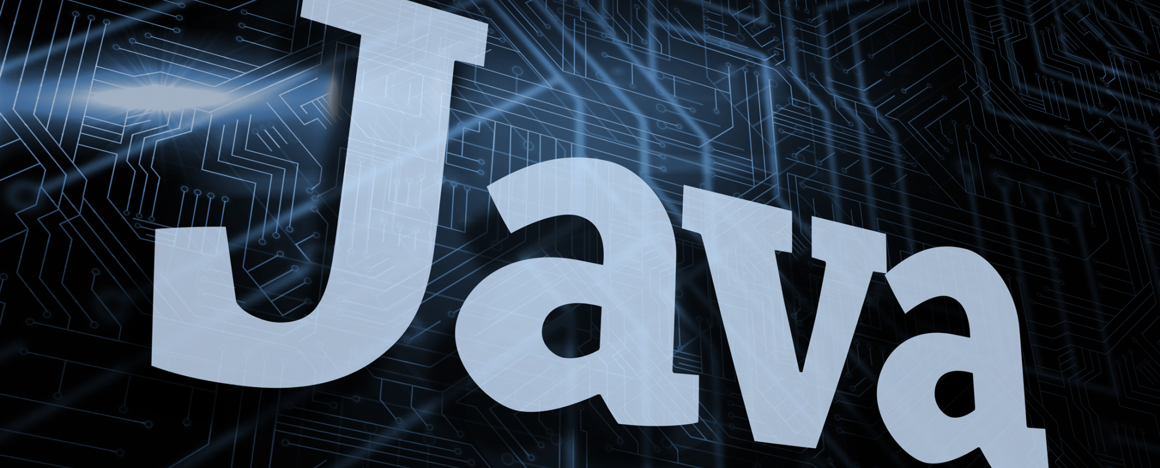
Inversion of Control Container
Spring is the most popular IoC in Java
Allows software to automatically modify itself
Hollywood Principle:
"Don't call us; we'll call you."
Notes:
Instructor notes:
Instructor Notes are the same as Participant Notes.
Please present the Participant Notes.
Participant Notes:
IoC stands for inversion of control introduced in the previous slide.

Slide 50

Advantages of IoC
Decouple execution from implementation
Focus on module or task
Rely on contracts
Prevent side effects
Much easier testing
Notes:
Instructor notes:
Instructor Notes are the same as Participant Notes.
Please present the Participant Notes.
Participant Notes:
Coupling' is a term that describes the relationship between two entities in a software system (usually classes).
When a class uses another class, or communicates with it, it's said to 'depend' on that other class, and so these classes are 'coupled'. At least one of them 'knows' about the other.
The idea is that we should try to keep the coupling between classes in our systems as 'loose' as possible: hence 'loose coupling' or sometimes 'decoupling' (although in English 'decoupling' would mean 'no coupling at all', people often use it to imply 'loose coupling' between entities).

Slide 51
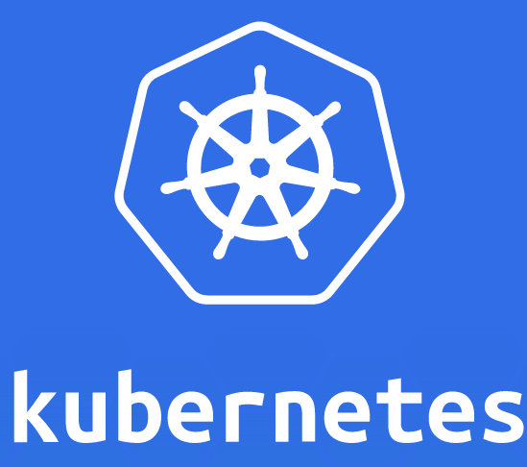
Microservices and Containers
Container frameworks facilitate microservices.
Kubernetes PODs:
Allows groups of containers to run together.
Facilitates microservices.
Notes:
Instructor notes:
Instructor Notes are the same as Participant Notes.
Please present the Participant Notes.
Participant Notes: Microservices may be a great design principle. But “implementation is left as an exercise to the reader.” Without good support, microservices would be just a dream. Kubernetes provides a good platform for microservices implementation. This will be discussed in the following sections.

Slide 52

Discussion: Serialization Protocols
Overview: Apply serialization protocols to your use case.
Time: 15 Minutes
In this exercise, you will: discuss the tradeoffs of serialization protocols and discuss the pluses and minus of each..
Instructions:
This is a full class discussion.
Questions:
What are the most important factors when it comes to serialization? For example, speed, disk consumption, compatibility with outside tools, human readability?
What are the considerations that lead you to make that decision? Are there standards and best practices within your organization?
Notes:
Instructor Notes:
Purpose: Apply the concepts of serialization protocols to our use case.
Questions:
What are the most important factors when it comes to serialization? For example, speed, disk consumption, compatibility with outside tools, human readability?
What are the considerations that lead you to make that decision? Are there standards and best practices within your organization?
Instruction Time Estimate: 15 Minutes.
Instructions: This is a full class discussion.
Answer: There is no right or wrong answer, but participants should give a reasoned response.
Follow-up/Debrief:
Participant Notes:
Note that there is no right or wrong answer, but this exercise hopefully will help you think through this for your use case.

Slide 53
Discussion: Authentication Standards
Overview: Discuss issues and considerations around authentication.
Time: 15 Minutes
In this exercise, let us think though the issues around authentication in our applications.
Instructions:
This is a full class discussion.
Questions:
What are expectations in the corporate setting around authentication? Are there standards already in place in your organization?
Are there are technologies in place that you should adhere to, such as LDAP or Active Directory? Is integration with this required, or even desirable? Discuss.
Notes:
Instructor Notes:
Purpose: Understand the requirements for authentication in our applications.
Questions:
What are expectations in the corporate setting around authentication? Are there standards already in place in your organization?
Are there are technologies in place that you should adhere to, such as LDAP or Active Directory? Is integration with this required, or even desirable? Discuss.
Instruction Time Estimate: 15 Minutes.
Instructions: This is a full class discussion.
Answer: There is no right or wrong answer, but participants should give a reasoned response.
Follow-up/Debrief:
Participant Notes:
Note that there is no right or wrong answer, but this exercise hopefully will help you think through this for your use case.

Slide 54
Lab: Spring Boot Lab With Authentication
Overview:
Time: 15
In this exercise, you will: implement a simple Spring Boot Application that implements authentication. You will see that Spring Boot takes much of the conficguration out of making a standard application.
Instructions:
Open the document: 300S-01-API-Labs.doc
Refer to the folder: 300S-01-API-Lab-Files
Notes:
Instructor Notes:
Purpose:. Develop a Spring Boot application with authentication.
Questions:
TBD
Instruction Time Estimate: 15 Minutes.
Instructions: This lab will involve participants working on their computers for a simple
Answer:
Follow-up/Debrief:
Participant Notes:
Please find the lab instructions in the file : 300S-01-API-Labs.docx. The accompanying lab files, which you will need to complete the lab, are also available in the 300S-01-API-Files folder.

Slide 55
Confidential property of Optum. Do not distribute or reproduce without express permission from Optum

